Slide 1
Angular with Java

Slide 2

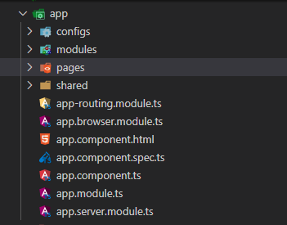
1. 시스템 소개
Component 구성도
<header>
root
component
<section>
<aside>
header
component
section
component
aside
component
footer
component
<article>
article
component
…
article
component
<footer>
Block Structure
Component Tree
Root Component
Root Module

Slide 3
1. 시스템 소개
통합시스템 구성도
Web Agent
Angular(Node.js)
Java Framework

